Slide 1

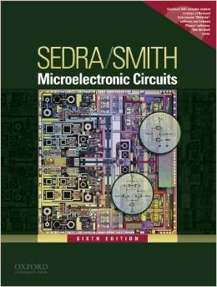
International University
School of Electrical Engineering
ANALOG ELECTRONICS
Lecture # 5: Feedback
Text book:
Sedra and Smith, “Microelectronic Circuits,” 6th Edition.
Souce: Blackboard to download materials

Slide 2
Introduction
IN THIS CHAPTER YOU WILL LEARN
The general structure of the negative-feedback amplifier and the basic principle that underlies its operation.
The advantages of negative feedback, how these come about, and at what cost.
The appropriate feedback topology to employ with each of the four amplifier types: voltage, current, trans-conductance, and trans-resistance.
Why and how negative-feedback amplifiers may be unstable (i.e. oscillate) and how to design the circuit to ensure stable performance.

Slide 3
Introduction
Most physical systems incorporate some sort of feedback.
Feedback can be negative (degenerative) or positive (regenerative).
Feedback may be used to:
desensitize the gain
reduce nonlinear distortion
reduce the effect of noise
control the input and output resistances
extend bandwidth
These characteristics result, however, in loss of gain.
“The basic idea of negative feedback is to trade-off gain for other desirable properties.”
Notes:
Most physical systems incorporate some form of feedback. It is interesting to note, though,
that the theory of negative feedback has been developed by electronics engineers. In his
search for methods for the design of amplifiers with stable gain for use in telephone
repeaters, Harold Black, an electronics engineer with the Western Electric Company,
invented the feedback amplifier in 1928. Since then the technique has been so widely used
that it is almost impossible to think of electronic circuits without some form of feedback,
either implicit or explicit.

Slide 4
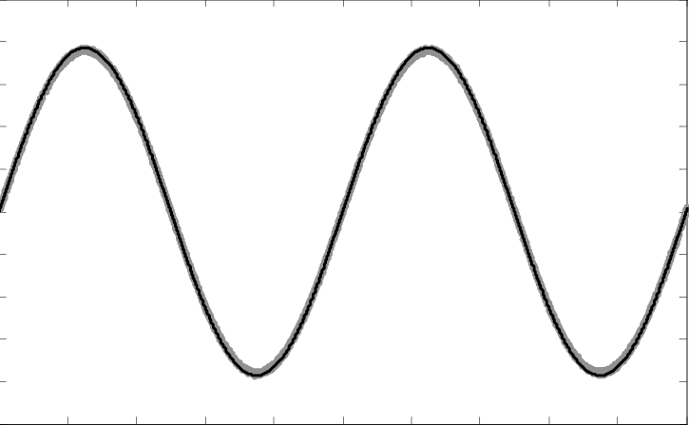
Introduction
Under certain conditions, negative feedback can be come positive.
This causes oscillation.
However, positive feedback does not always lead to instability.
Regenerative feedback has a number of applications – specifically, in active filtering.
output
No input
Oscillation circuit

Slide 5
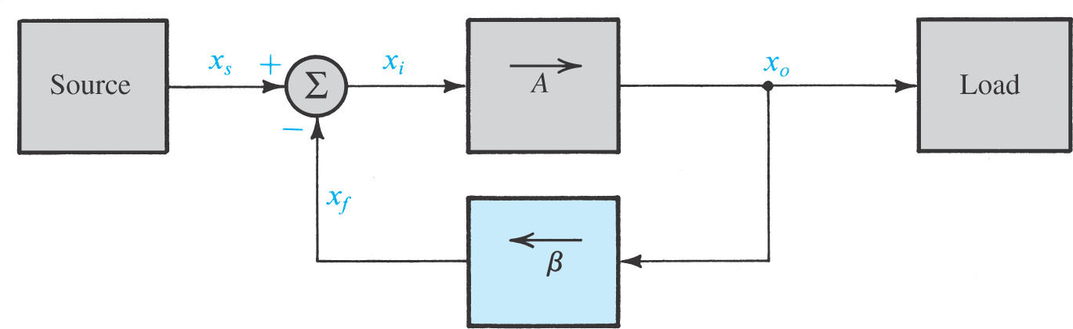
10.1. The General Feedback Structure
Figure 10.1. shows the basic structure of a feedback amplifier – signal-flow diagram.
Open-loop amplifier has gain A (x_{o} = Ax_{i}).
In electronic circuits, part of or all output signal is fed back to input, and affects the input signal value, which is called feedback.
Figure 10.1: General structure of the feedback amplifier. This is a signal-flow diagram, and the quantities x represent either voltage or current signals.

Slide 6


10.1. The General Feedback Structure
■ Open-loop gain: A
■ Feedback factor: β → x_{f} = βx_{o}
■ Loop gain: Aβ
■ Amount of feedback: 1 + Aβ
■ Gain of the feedback amplifier (closed-loop gain):
Negative feedback:
■ The feedback signal x_{f} is subtracted from the source signal x_{s}
■ Negative feedback reduces the signal that appears at the input of the basic
amplifier
■ The gain of the feedback amplifier A_{f} is smaller than open-loop gain A by a factor of (1+Aβ)
The loop gain Aβ is typically large (Aβ >>1):
■ The gain of the feedback amplifier (closed-loop gain) A_{f} ≅ 1/ β
■ The closed-loop gain is almost entirely determined by the feedback network
β better accuracy of A_{f}
■ → error signal x_{i} = x_{s} – x_{f}
x_{o} = Ax_{i} = A(x_{s} – x_{f})
x_{o} = A(x_{s} – βx_{o})
A_{f} = x_{o}/x_{s} = A/(1+Aβ)

Slide 7
Negative feedback and positive feedback according to the effecting of feedback
1) positive feedback increases the signal that appears at the input of the basic amplifier
2) negative feedback reduces the signal that appears at the input of the basic amplifier
DC feedback and AC feedback
Feedback quantity only contains DC quantity→ is called DC
feedback
2) Feedback quantity only contains AC quantity→ is called AC
feedback
Usually AC feedback and DC feedback are concomitant

Slide 8
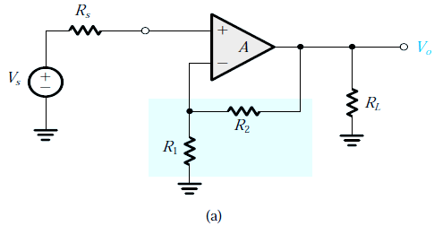
Example 10.1
The feedback amplifier is based on an opamp with infinite input resistance and zero output resistance
(a) Find an expression for the feedback factor.
(b) Find the condition under which the closed-loop gain A_{f} is almost entirely determined by the feedback network.
(c) If the open-loop gain A = 10000 V/V, find R₂/R₁ to obtain a closed-loop gain A_{f} of 10 V/V.
(d) What is the amount of feedback in decibel?
(e) If V_{s} = 1 V, find V_{o}, V_{f} and V_{i}.
(f) If A decreases by 20%, what is the corresponding decrease in A_{f}?
Fig. 10.2 (a) A non-inverting op-amp circuit for Example 10.1.

Slide 9

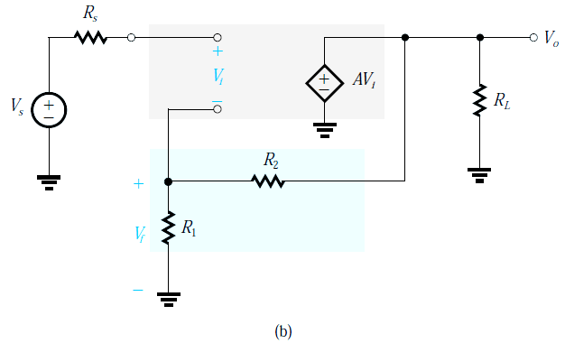
Solution
(a) Fig. 10.2(a) has the equivalent-circuit model, as shown in Fig. 10.2(b). The op amp is simply an ideal voltage-controlled voltage source of gain A. From Fig. 10.2(b) : the feedback network, consisting of the voltage divider (R₁, R₂), is connected directly to the output and feeds a signal V_{f} to the inverting input terminal of the op amp. → the zero output resistance of the op amp causes the output voltage to be AV_{i} irrespective of the values of R₁ & R₂ and of R_{L}. Thus, the feedback network and the load are assumed not to load the basic amplifier. Now we can easily determine the feedback factor β from
How is V_{f} subtracted from V_{s} at the input side?
+ No current flows in R_{s} → value of R_{s} doesn’t effect on V_{i} or the source “does not load” the amplifier input.
+ V_{f} will depend only on the ratio R₁/R₂ and not on the absolute values of R₁ & R₂
V_{f}
Fig. 10. 2 (b) The circuit in (a) with the op-amp replaced with its equivalent circuit.

Slide 10






Solution
(b) The closed-loop gain A_{f} is given by A_{f} = A / (1 + Aβ). We assume that Aβ >> 1
The condition can be stated as A >> A_{f}
(c ) For A = 10000 V/V & A_{f} = 10 V/V. It means that A >> A_{f}. Thus we can select R₁ & R₂ to obtain β = 1/A_{f} = 0.1 . Thus
R₂ / R₁ = 9 (approximation)
β = 0.0999 & R₂/R₁ = 9.01 (exact value)
(d) The amount of feedback is
which is 60 dB
(e) For V_{s} = 1 V → V_{o} = A_{f}V_{s} = 10 × 1 = 10 V and V_{f} = βV_{o} = 0.0999 × 10 = 0.999 V
V_{i} = V_{o} / A = 10 / 10⁴ = 0.001 V
(f) If A decreases by 20%, thus becoming A = 0.8 × 10⁴ V/V
A_{f} = 0.8 × 10⁴ / (1 + 0.8 × 10⁴ × 0.0999) = 9.9975 V/V
that is, it decreases by 0.025%, which is lower than the percentage change in A by approximately a factor (1 + Aβ)

Slide 11

10.2. Some Properties of Negative Feedback
The effect of negative feedback on desensitizing the closed-loop gain was demonstrated in Example 10.1, where we saw that a 20% reduction in the gain of the basic amplifier gave rise to only a 0.025% reduction in the gain of the closed-loop amplifier.
10.2.1. Gain De-sensitivity dA_{f}
Equations (10.8) and (10.9) define de-sensitivity factor of (1+Aβ).
$$A_{f}=\frac{A}{1+Aβ}$$
(10.8)
(10.9)
The percentage change in A_{f} (due to variations in some circuit parameter) is smaller than the percentage change in A by the amount of feedback. For this reason the amount of feedback, 1 + Aβ, is also known as the de-sensitivity factor.

Slide 12



10.2. Some Properties of Negative Feedback
10.2.2. Bandwidth Extension
Equations (10.10) through (10.13) demonstrate how 3-dB frequencies may be shifted via negative feedback.
Consider an amplifier whose high-frequency response is characterized by a single pole. Its gain at mid and high frequencies can be expressed as
(10.10)
where A_{M} denotes the midband gain and ω_{H} is the upper 3-dB frequency.
Application of negative feedback, with a frequency-independent factor β, around this amplifier results in a closed-loop gain A_{f}(s) given by
(10.11)
Thus the feedback amplifier will have a midband gain of A_{M}/(1+A_{M}β) and an upper 3-dB frequency ω_{Hf} = ω_{H}(1+A_{M}β). (10.12)
Similarly, the open-loop gain is characterized by a dominant low frequency pole, then it has the feedback amplifier with a lower 3-dB frequency
ω_{Lf} = ω_{L} / (1 + A_{M}β) (10.13)
Note that the amplifier bandwidth is increased by the same factor by which its midband gain is decreased, maintaining the gain-bandwidth product at a constant value.

Slide 13
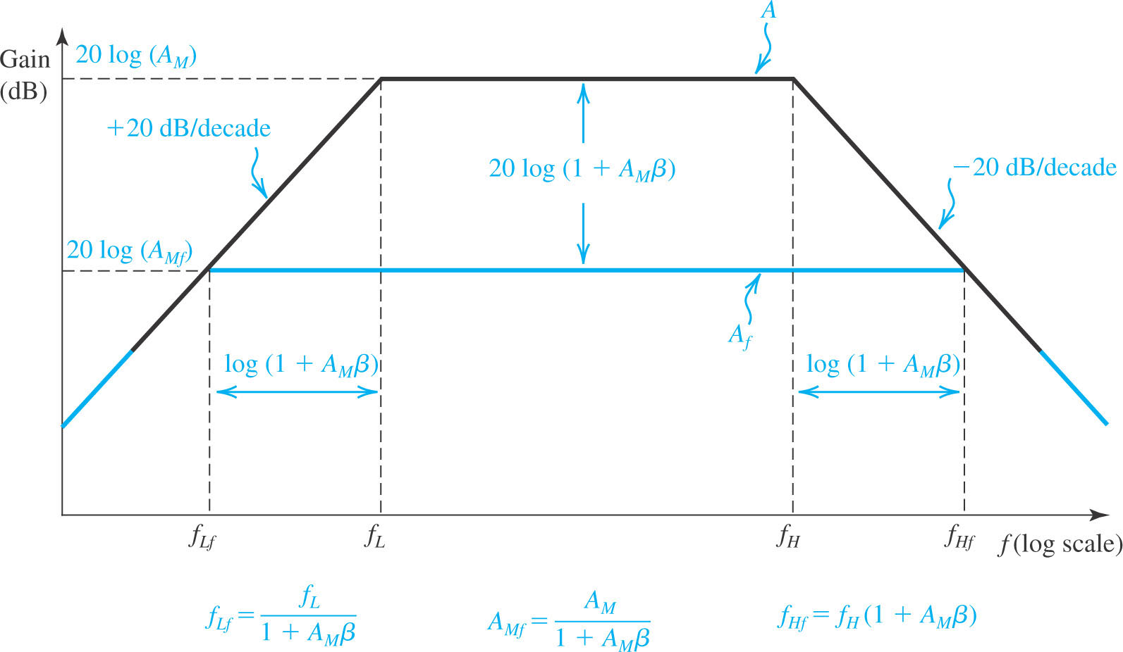
Negative feedback:
Reduces the gain by a factor of (1+A_{M}β)
Extends the bandwidth by a factor of (1+A_{M}β)

Slide 14
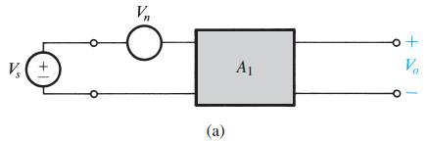
10.2. Some Properties of Negative Feedback
10.2.3. Interference Reduction
Negative feedback can be employed to reduce the interference in an amplifier
Signal-to-interference ratio (S/I = V_{s}/V_{n}) (10.14)
interference,
Figure 10.4 Illustrating the application of negative feedback to improve the signal-to-interference ratio in amplifiers.

Slide 15


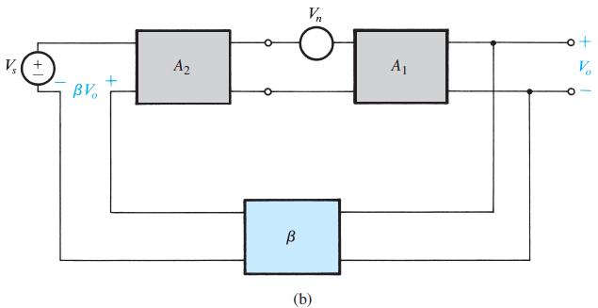
10.2. Some Properties of Negative Feedback
Consider the circuit in Fig. 10.4(b). Here we assume that another amplifier stage with gain A₂ that does not suffer from the interference problem.
The output voltage of the circuit in Fig. 10.4(b) can be found by superposition:
which is times higher than in the original case
Figure 10.4: Illustrating the application of negative feedback to improve the signal-to-interference ratio in amplifiers.

Slide 16
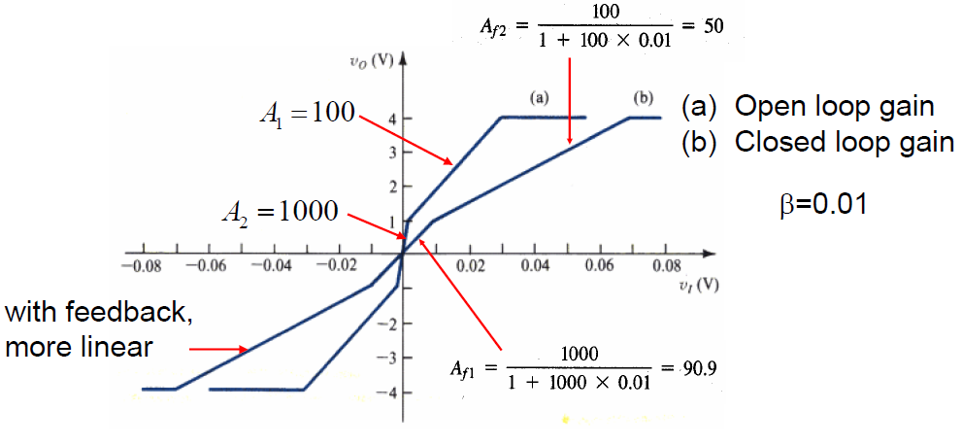
10.2. Some Properties of Negative Feedback
10.2.4. Reduction in Nonlinear Distortion
The amplifier transfer characteristic is linearized through the application of negative feedback

Slide 17
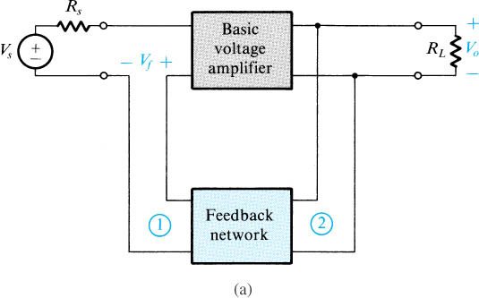
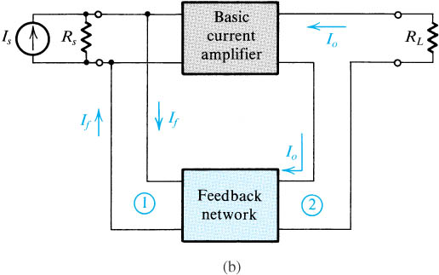
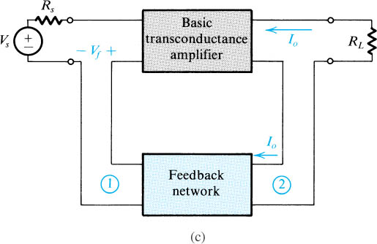
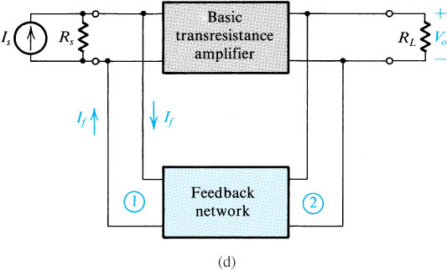
10.3. The Four Basic Feedback Topologies
Figure: 4 basic feedback topologies: (a) voltage-mixing voltage-sampling (series–shunt) topology; (b) current-mixing current-sampling (shunt–series) topology; (c) voltage-mixing current-sampling (series–series) topology; (d) current-mixing voltage-sampling (shunt–shunt) topology.

Slide 18
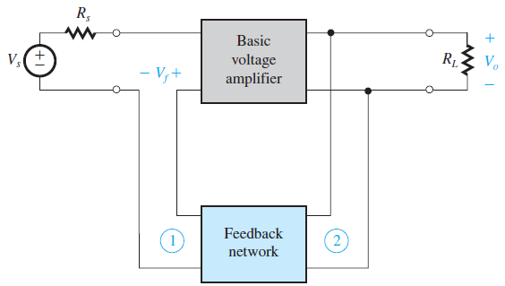
10.3.1. Voltage Amplifiers
voltage amplifiers – accept input voltage and yield output voltage.
voltage-controlled voltage source (VCVS)
The feedback network should sample the output voltage. Also, because of the Thévenin representation of the source, the feedback signal x_{f} should be a voltage that can be mixed with the source voltage in series.

Slide 19
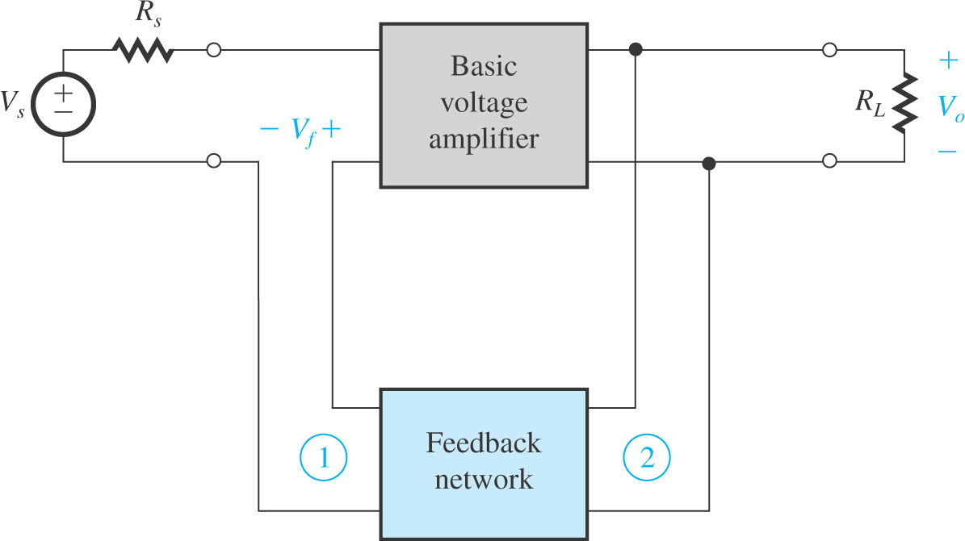
10.3.1. Voltage Amplifiers
voltage-mixing / voltage-sampling – is the topology most suitable for voltage amps (Fig. 10.6).
Is also known as series-shunt feedback.
Input resistance ↑ due to series connection
Output resistance ↓ due to shunt connection
Figure 10.6: Block diagram of a feedback voltage amplifier. Here the appropriate feedback topology is series–shunt.

Slide 20
10.3.1. Voltage Amplifiers
Increased input resistance results because V_{f} subtracts from V_{s}, resulting in smaller signal V_{i} at the input.
Low V_{i} causes input current to be smaller.
This effects higher input resistance.
Decrease output resistance results because feedback works to keep V_{o} as constant as possible.
ΔV_{o} and ΔI_{o} change / vary together.
This effects lower output resistance.

Slide 21
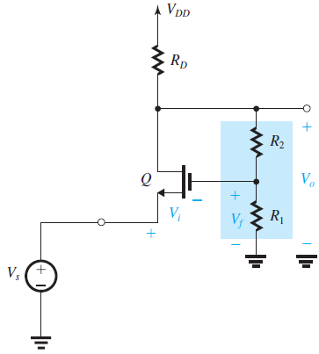
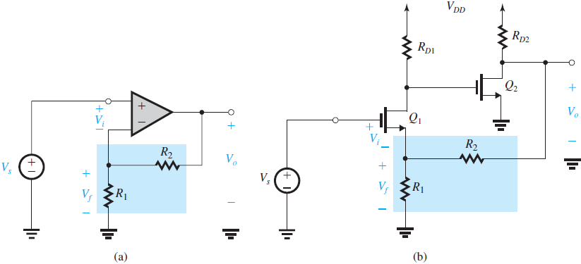
Series-Shunt Examples
(c)
Figure 10.7: Examples of a feedback voltage amplifier. All these circuits employ series–shunt feedback. Note that the dc bias circuits are only partially shown.
Noninverting op-amp. The feedback network:
R1, R2, develops a voltage that is applied to the
negative input terminal of the op amp.
As V_{s} ↑, V_{o} ↑ and V_{f} ↑. Thus the change in V_{f} is of the same polarity as the change in V_{s} and the feedback is negative.
2 FET amplifier stages in cascade. V_{o} is sampled by the feedback network composed of the voltage divider (R₁, R₂), and the feedback signal is fed to the source terminal of Q₁.
Vs ↑, drain voltage of Q₁ ⇓, voltage gate of Q₂ ⇓, → drain voltage of Q₂↑
The feedback network will then cause V_{s} to ↑, which is the same change in polarity initially assumed for V_{s}. Thus the feedback is indeed negative
CG transistor Q. Subtraction of V_{f} from V_{s} is effected by applying V_{s} to the source, → input V_{i} = V_{s} – V_{f}.
If V_{s} ↑ → V_{d} (which is V_{o}) ↑ & V_{f} ↑ → V_{f} & V_{s} change in the same direction, verifying
that the feedback is negative.

Slide 22
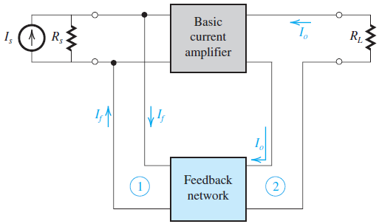
10.3.2. Current Amplifiers
current amplifier – accepts input current to generate output current.
CCCS
Norton Source
current-mixing / current-sampling – topology is most suitable for current amps.
Is also known as shunt-series feedback.
It not only stabilizes the current gain but also provides low input resistance/high output resistance.
Feedback network should sample the output current.
Feedback signal should be in current form so that it may be
mixed in shunt with the source current.
Block diagram of a feedback current amplifier. Here, the appropriate feedback topology is the shunt–series.
Notes:
CCCS = current control current source

Slide 23
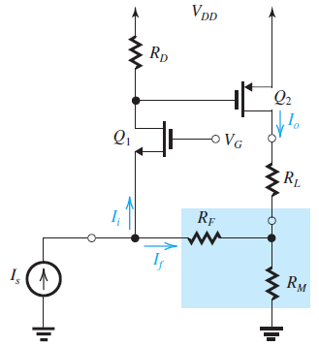
10.3.2. Current Amplifiers
a CG stage Q₁ followed by a CS stage Q₂.
A sample of I_{o} is obtained by placing a small resistance R_{M} in series with R_{L}.
The voltage developed across R_{M} is fed via a large resistance R_{F} to the source node of Q₁. The feedback current I_{f} that flows through R_{F} is subtracted from I_{s} at the source node, resulting in the input current I_{i} = I_{s} - I_{f}.
I_{s} ↑ causes I_{i} to increase and the drain voltage of Q₁ will ↑ → ↑ the gate voltage of the p-channel device Q₂,→ I_{o} drain current of Q₂ ↓ → the voltage across R_{M} will ↓, → I_{f} ↑.
Figure 10.8: Example of a feedback current amplifier.

Slide 24
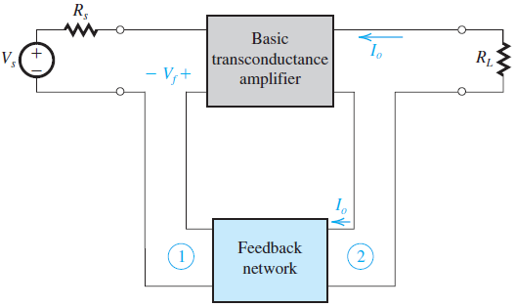
10.3.3. Transconductance Amplifiers
transconductance amplifier – accepts input voltage and generates output current.
VCCS
Norton Source Output
voltage-mixing / current-sampling – topology is most suitable for transconductance amps.
Is also known as series-series feedback.
The sampling of the output current results in an increased output resistance. →series–series feedback topology provides the transconductance amplifier with the desirable properties of increased input and output resistances.
Figure 10.10: (a) Block diagram of a feedback transconductance amplifier. Here, the appropriate feedback topology is series–series.

Slide 25
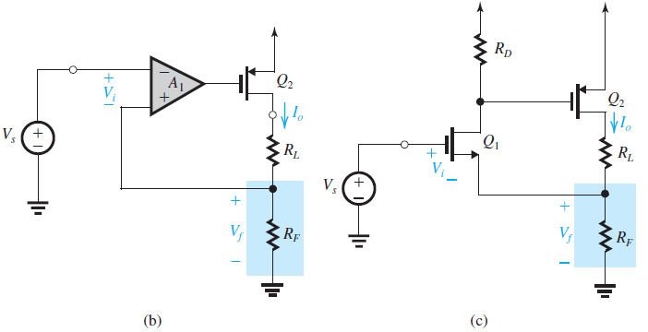
A differential amplifier A₁ followed by a CS stage Q₂.
↑ V_{s} will result in a negative change at the gate of Q₂ → ↑ I_{o}. → ↑ V_{f} , which is the
same polarity assumed for the change in V_{s} ➔ the feedback is negative.
A CS amplifier Q₁ in cascade with another CS amplifier Q₂.
Figure 10.10: (b) Example of a feedback transconductance amplifier. (c) Another example.

Slide 26
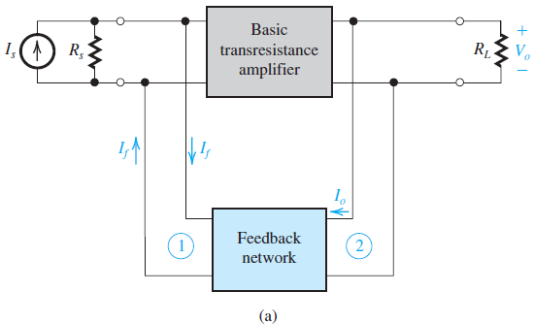
10.3.4. Transresistance Amplifiers
transresistance amplifier – accepts input current and generates output voltage.
CCVS
Thevenin Source Output
current-mixing / voltage-sampling – topology is most suitable for current amps.
Is also known as shunt-shunt feedback.
Provides low input resistance/low output resistance.
Figure 10.11: (a) Block diagram of a feedback transresistance amplifier. Here, the appropriate feedback topology is shunt–shunt.

Slide 27
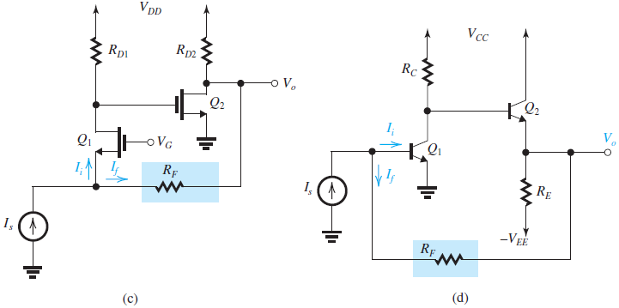
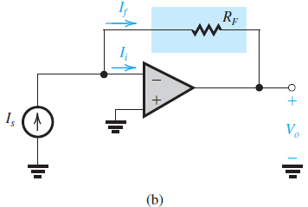
Examples of feedback transresistance amplifiers
A CG stage Q₁ cascaded with a CS stage Q₂. A feedback
resistor R_{F} senses V_{o} and feeds a current i_{f} to the input node, where the subtraction
from I_{s} takes place.
a CE stage Q₁ cascaded with an emitter follower Q₂. A feedback resistor R_{F} senses V_{o} and feeds back a current I_{f} to the input node, where it is subtracted from I_{s}.
An op amp with a feedback resistance R_{F} that senses V_{o} and provides a feedback current I_{f} that is subtracted from I_{s} at the input node.
Figure 10.11: (b), (c), and (d) Examples of feedback transresistance amplifiers.

Slide 28
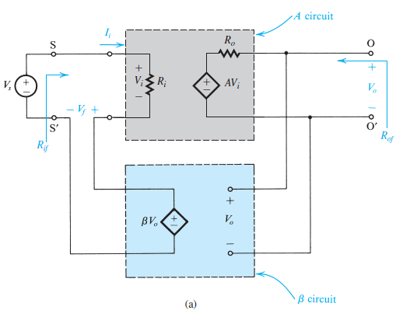
10.4. The Feedback Voltage Amplifier (Series–Shunt)
Series-shunt is appropriate feedback for voltage amplifier. It consists of
Unilateral open-loop amplifier (circuit A).
Ideal Voltage-Sampling, voltage-mixing feedback network (β circuit)
Input resistance R_{i}
Open Circuit Gain A
Output resistance R_{o}
Note that the β circuit does not load the A circuit; that is, connecting the β circuit does not change the value of A
(A = V_{o} / V_{i})
Figure 10.12: The series–shunt feedback amplifier: (a) ideal structure

Slide 29
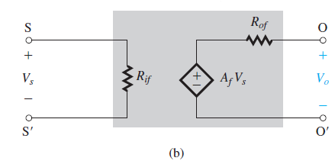
Figure 10.12: (b) equivalent circuit of The series–shunt feedback amplifier
A_{f} is the open-circuit voltage gain of the feedback amplifier, R_{if} is its input resistance, and R_{of} is its output resistance.

Slide 30
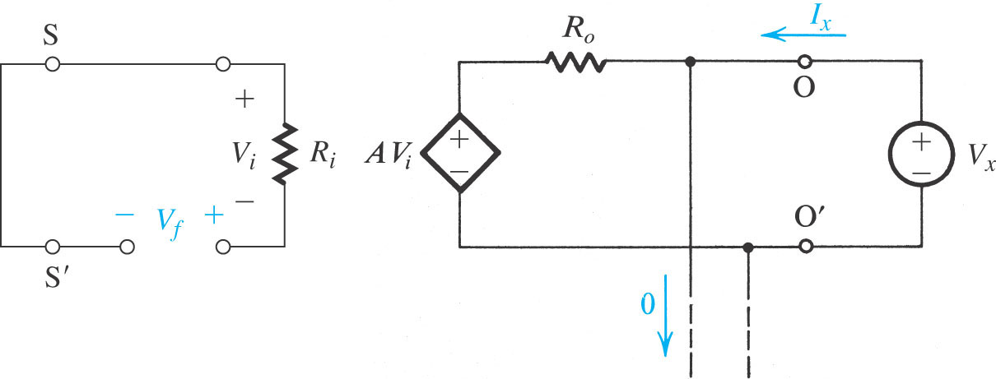
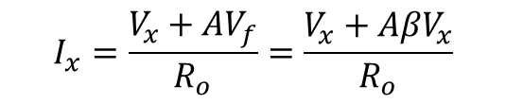
The Ideal Case
The circuit of Fig. 10.12(a) has:
$$I_{x}=\frac{V_{x}+AV_{f}}{R_{o}}=\frac{V_{x}+A{βV}_{x}}{R_{o}}$$

Slide 31

Fig. 10.13 is used to determine the output resistance R_{of} of the feedback amplifier.
Set V_{s} = 0 and apply a test voltage V_{x}
Output resistance of the feedback amplifier
Figure 10.13: Determining the output resistance of the feedback amplifier of Fig. 10.12(a): R_{of} = V_{x} /I_{x}.

Slide 32
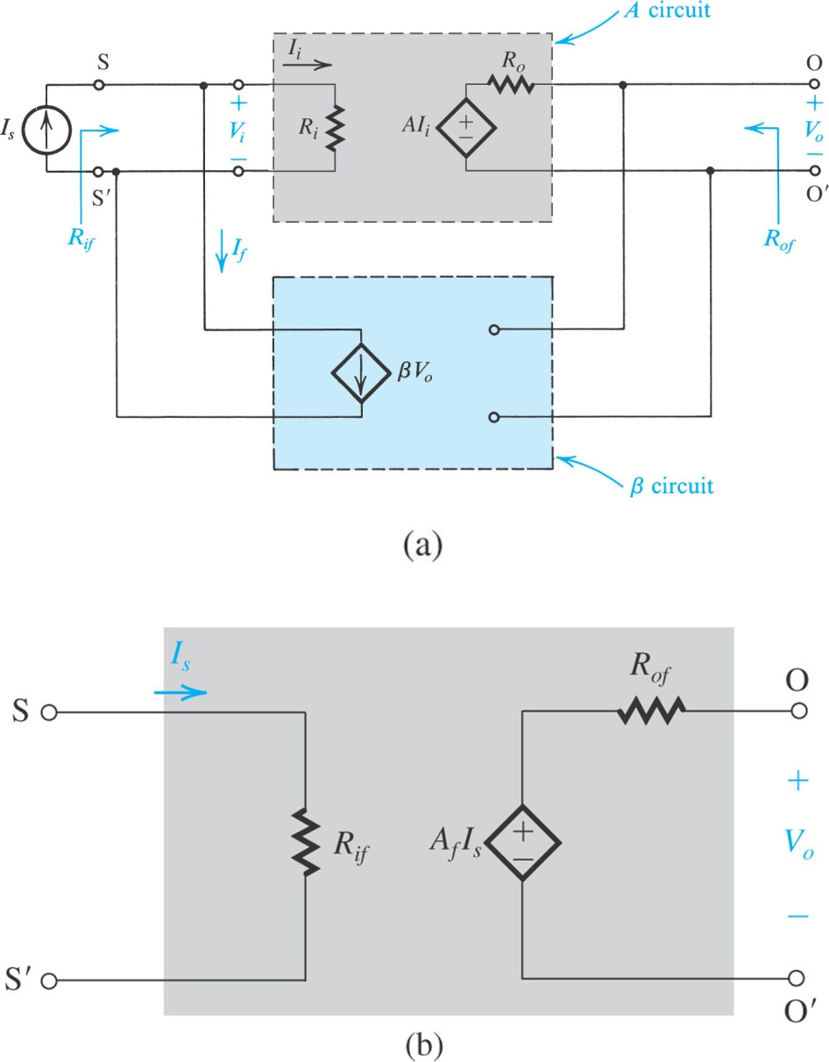



10.5. The Feedback Transresistance Amplifier (Shunt–Shunt)
Ideal case
Input resistance of the feedback amplifier
Output resistance of the feedback amplifier
Voltage gain of the feedback amplifier
Figure 10.24: (a) Ideal structure for the shunt–shunt feedback amplifier. (b) Equivalent circuit of the amplifier in (a).

Slide 33
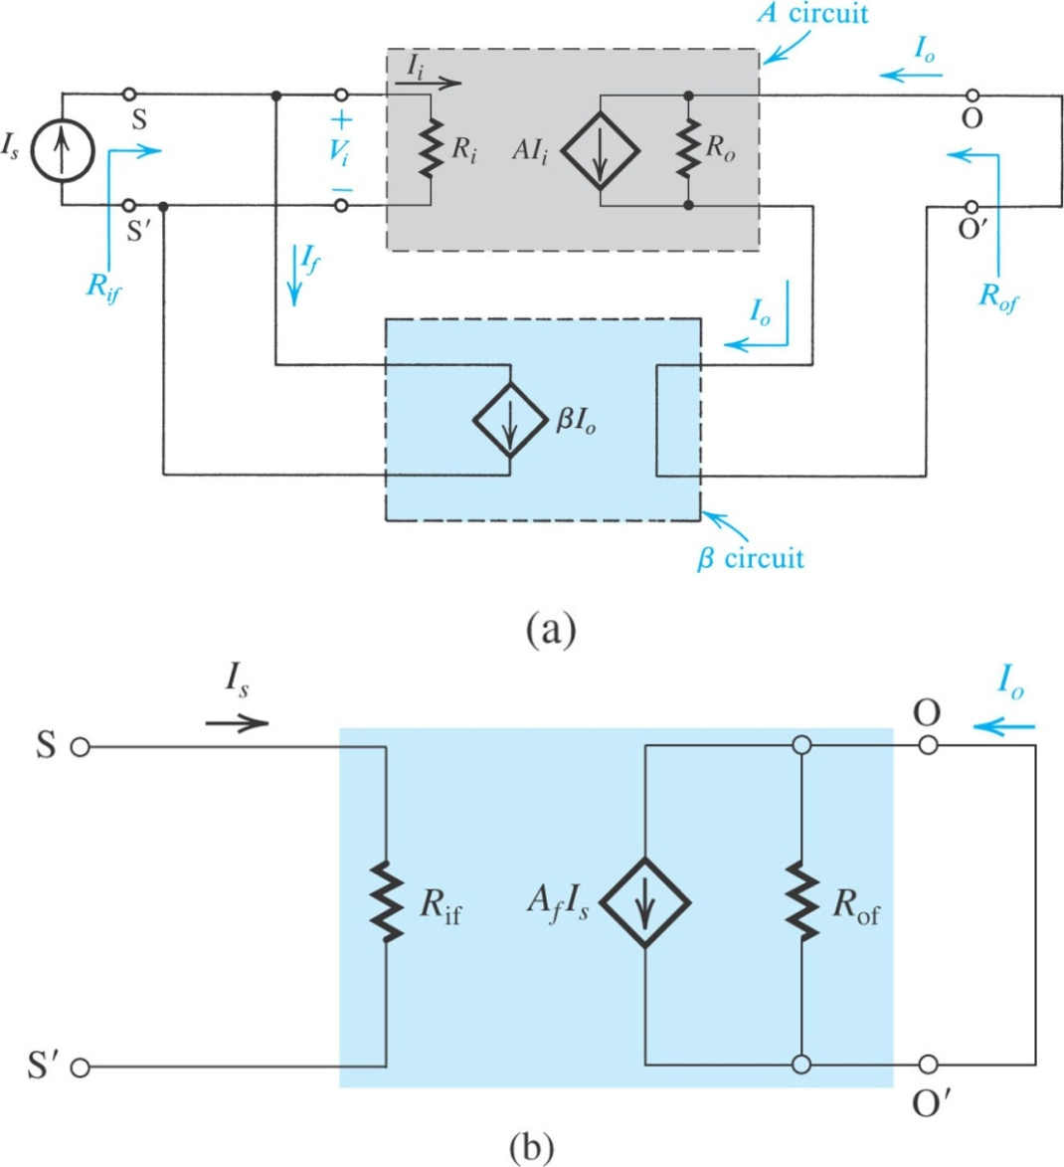


10.6. The Feedback Current Amplifier (Shunt–Series)
Ideal case
Input resistance of the feedback amplifier
Output resistance of the feedback amplifier
R_{of} = (1 + Aβ )R_{o}
Voltage gain of the feedback amplifier
Figure 10.28: (a) Ideal structure for the shunt–series feedback amplifier. (b) Equivalent circuit of the amplifier in (a).

Slide 34
10.7. Summary of Feedback Analysis Method
Always begin analysis by determining an approximate value for the closed-loop gain (A_{f}).
Assume that loop gain Aβ is large.
A_{f} = 1/β
This value should serve for final check on A_{f}.
The shunt connection at input or output will always result in reducing the corresponding resistance.
In utilizing negative feedback to improve the properties of an amplifier under design, the starting point is selection of feedback topology.
Feedback factor (β.) may be determined as 1/A_{f}.

Slide 35
10.8 The Stability Problem
10.8.1 Transfer Function of the Feedback Amplifier
In a feedback amplifier, the open loop gain (A) is generally a function of frequency.
Therefore, it should be called open-loop transfer function A(s).
One big question is: What happens to gain at higher frequencies?
This has huge implications on stability of the amplifier.

Slide 36
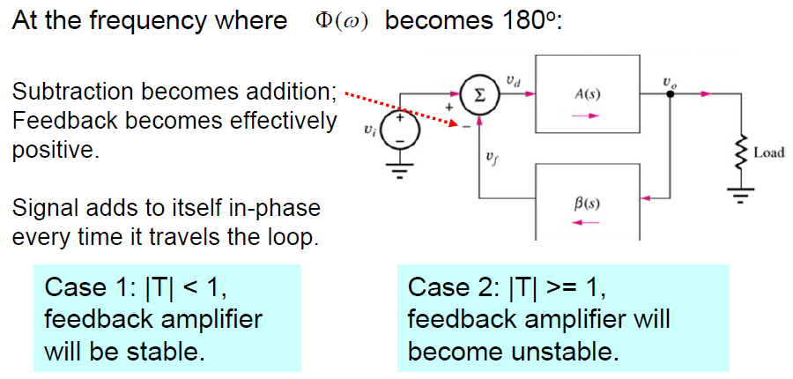
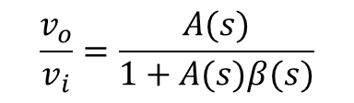
10.8 The Stability Problem
10.8.1 Transfer Function of the Feedback Amplifier
$$\frac{v_{o}}{v_{i}}=\frac{A(s)}{1+A(s)β(s)}$$
|L|
|L|

Slide 37
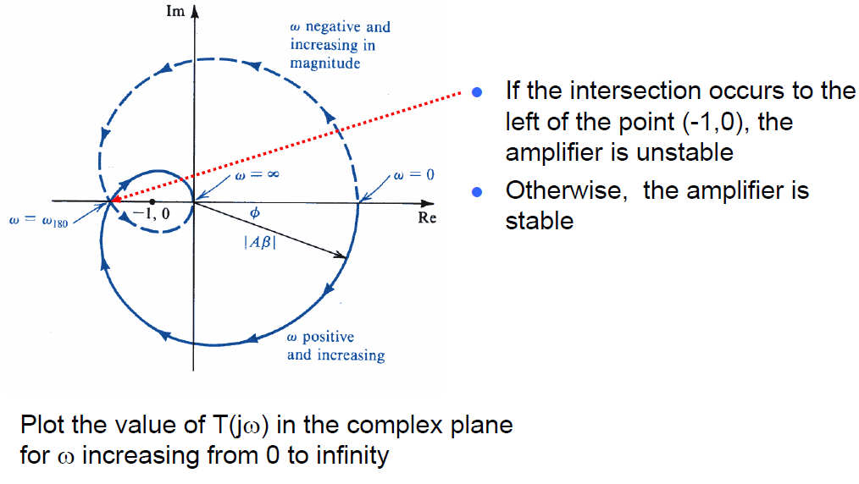



10.8.2. Nyquist Plot
A plot used to evaluate the stability of a feedback amplifier
Plot the loop gain versus frequency on the complex plane
Stability:
The plot does not encircle the point (-1, 0)

Slide 38
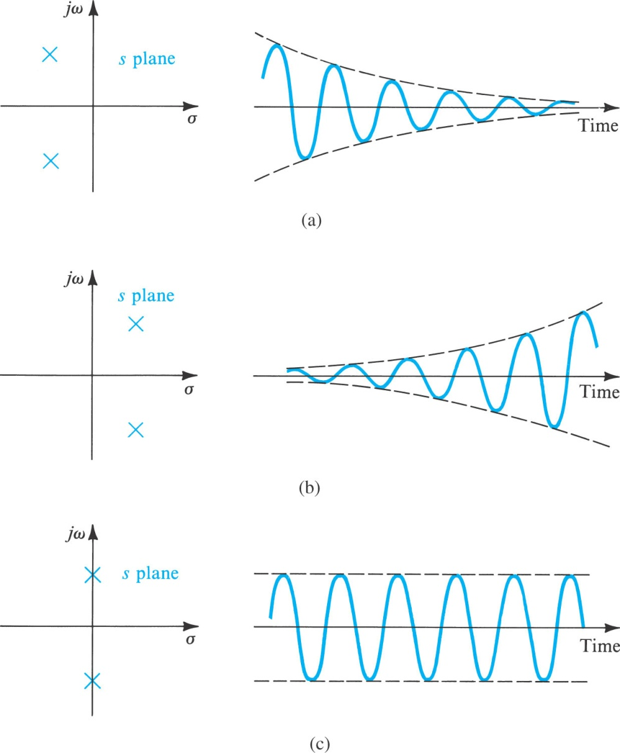

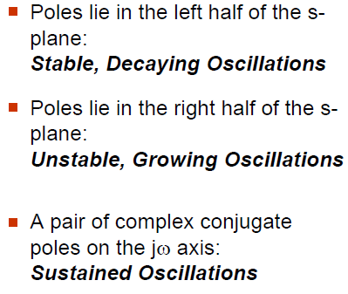
10.9. Effect of Feedback on the Amplifier Poles
The amplifier frequency response and stability are determined directly by its poles
The impulse response for a transfer
function with poles at σ_{o}±jω_{n} will
contain the term:
Figure 10.35: Relationship between pole location and transient response.

Slide 39
Poles of the Feedback Amplifier
The feedback amplifier poles are obtained by solving the characteristic equation
→ Called characteristic equation
Amplifier with single-pole response
feedback moves the pole along the negative real axis

Slide 40
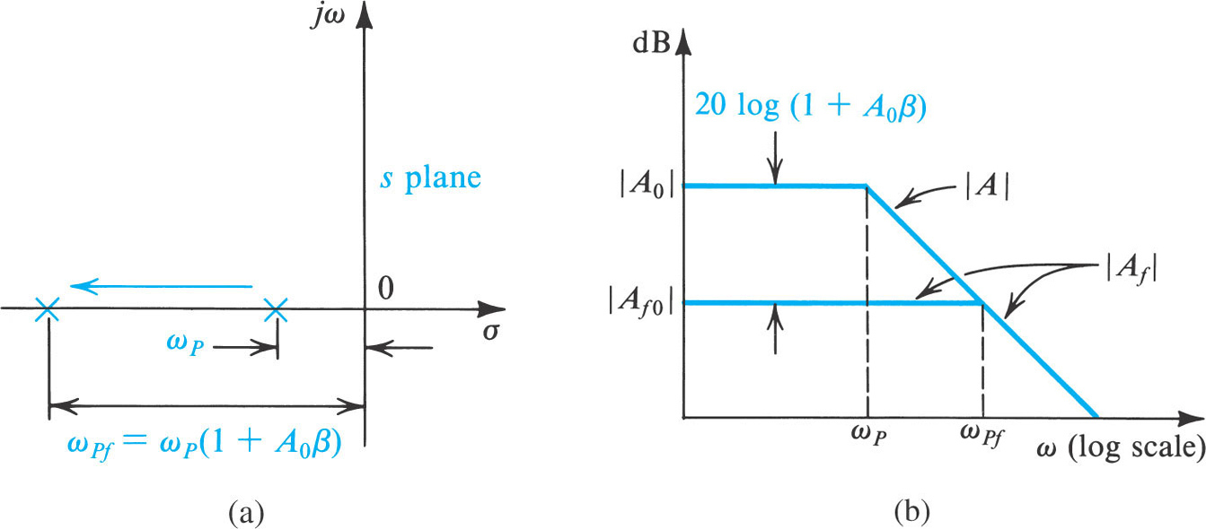
10.10. Effect of Feedback on the Amplifier Poles
The feedback amplifier is still a single-pole system
The pole moves away from origin in the s-plane as feedback (β) increases
The bandwidth is extended by feedback at the cost of a reduction in gain
Unconditionally stable system (the pole never enters the right-half plane)
Figure 10.36: Effect of feedback on (a) the pole location and (b) the frequency response of an amplifier having a single-pole, open-loop response.

Slide 41
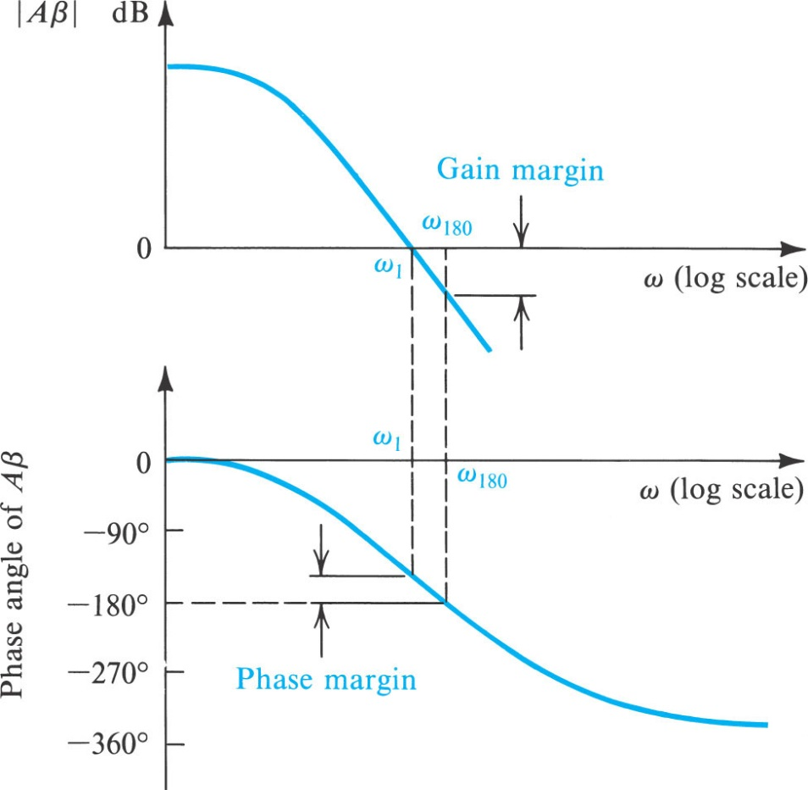
10.11. Stability Study Using Bode Plots
Gain and phase margin
+ The stability of a feedback amplifier is determined by examining its loop gain as a function of frequency.
+ One of the simplest means is through the use of Bode plot for Aβ.
Stability is ensured if the magnitude of the loop gain is less than unity at a frequency shift of 180°.
* Gain margin:
+ The difference between the value |Aβ| of at ω₁₈₀ and unity.
+ Gain margin represents the amount by which the loop gain can be increased while maintaining stability.
* Phase margin:
A feedback amplifier is stable if the phase is
less than 180° at a frequency for which |Aβ| =1.
A feedback amplifier is unstable if the phase is
in excess of 180° at a frequency for which |Aβ| =1.
The difference between the a frequency
for which |Aβ| =1 and 180°.
Figure 10.42 Bode plot for the loop gain Aβ illustrating the definitions of the gain and phase margins

Slide 42
Summary
Negative feedback is employed to make the amplifier gain less sensitive to component variations; to control input and output impedances; to extend bandwidth; to reduce nonlinear distortion; and to enhance signal-to-interference ratio.
The advantages above are obtained at the expense of a reduction in gain and at the risk of the amplifier becoming unstable (that is, oscillating). The latter problem is solved by careful design.
For each of the four basic types of amplifier, there is an appropriate feedback topology. The four topologies, together with their analysis procedures, are summarized in Table 10.1.

Slide 43
Summary
The key feedback parameter are the loop gain (Aβ.), which for negative feedback must be a positive dimensionless number, and the amount of feedback (1+Aβ.). The latter directly determines gain reduction, gain desensitivity, bandwidth extension, and changes in input and output resistances.
Since A and β are in general frequency dependent, the poles of the feedback amplifier are obtained by solving the characteristic equation 1+A(s)β(s) = 0.
For the feedback amplifier to be stable, its poles must all be in the left-hand side of the s-plane.
Stability is guaranteed if at the frequency for which the phase angle of Aβ is 180^{O}, |Aβ| is less than unity; the amount by which it is less than unity, expressed in decibels, is the gain margin. Alternatively, the amplifier is stable if, at the frequency at which |Aβ| = 1, the phase angle is less than 180^{O}, the difference ifs the phase margin.

